Slide 1




Slide 2

Activity Selection Problem

Slide 3

TEST TIME ON KRUSKAL'S ALGORITHM
URL:https://forms.gle/UEMmeQcjPSFFMrMq6
QR CODE:

Slide 4
GREEDY ALGORITHMS
Introduction:
A greedy algorithm is any algorithm that follows the problem-solving heuristic of making the locally optimal choice at each stage
In many problems, a greedy strategy does not produce an optimal solution, but a greedy heuristic can yield locally optimal solutions that approximate a globally optimal solution in a reasonable amount of time.
Example: In Travelling Sales Problem, the heuristic is "At each step of the journey, visit the nearest unvisited city."
This problem has unreasonably many steps and greedy approach limits them

Slide 5
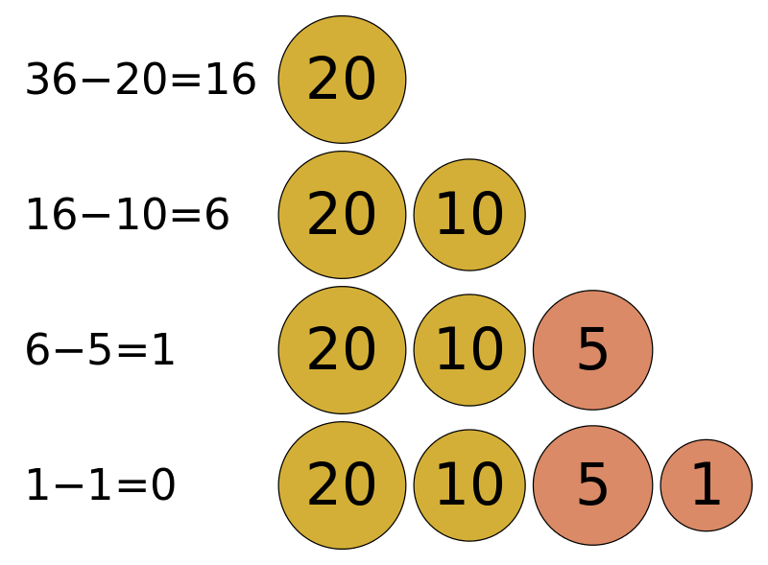
GREEDY ALGORITHMS
Example
Greedy algorithms determine the minimum number of coins to give while making change.
The image represents the steps most people would take to emulate a greedy algorithm to represent 36 cents using only coins with values {1, 5, 10, 20}.
The coin of the highest value, less than the remaining change owed, is the local optimum.

Slide 6
GREEDY ALGORITHMS
Properties:
Greedy Algorithm solves problems by making the best choice that seems best at the particular moment.
A greedy algorithm works if a problem exhibits the following two properties:
1. Greedy Choice Property: A globally optimal solution can be reached at by creating a locally optimal solution. In other words, an optimal solution can be obtained by creating "greedy" choices.
2. Optimal substructure: Optimal solutions contain optimal subsolutions. In other words, answers to subproblems of an optimal solution are optimal.

Slide 7
ACTIVITY SELECTION PROBLEM
Introduction:
Recap: At every step, we can make a choice that looks best at the moment, and we get the optimal solution of the complete problem.
Activity Selection Problem is a fine example of a Greedy Algorithm
Problem Statement: You are given n activities with their start and finish times. Select the maximum number of activities that can be performed by a single person, assuming that a person can only work on a single activity at a time.

Slide 8
ACTIVITY SELECTION PROBLEM
Introduction:
Recap: At every step, we can make a choice that looks best at the moment, and we get the optimal solution of the complete problem.
Activity Selection Problem is a fine example of a Greedy Algorithm
Problem Statement: You are given n activities with their start and finish times. Select the maximum number of activities that can be performed by a single person, assuming that a person can only work on a single activity at a time.

Slide 9
ACTIVITY SELECTION PROBLEM
Examples
Consider the following examples
Input
start[] = {10, 12, 20};
finish[] = {20, 25, 30};
Output
{0,2}
Explanation
A person can perform at most two activities. The maximum set of activities that can be executed is {0, 2}
These are indexes in start[] and finish[]
Input
start[] = {1, 3, 0, 5, 8, 5};
finish[] = {2, 4, 6, 7, 9, 9};
Output
{0, 1, 3, 4}
Explanation
A person can perform at most four activities. The maximum set of activities that can be executed is {0, 1, 3, 4}

Slide 10
ACTIVITY SELECTION PROBLEM
Algorithm:
The greedy choice is to always pick the next activity whose finish time is least among the remaining activities and the start time is more than or equal to the finish time of the previously selected activity.
1) Sort the activities according to their finishing time
2) Select the first activity from the sorted array and print it.
3) Do the following for the remaining activities in the sorted array.
If the start time of this activity is greater than or equal to the finish time of the previously selected activity then select this activity and print it.

Slide 11
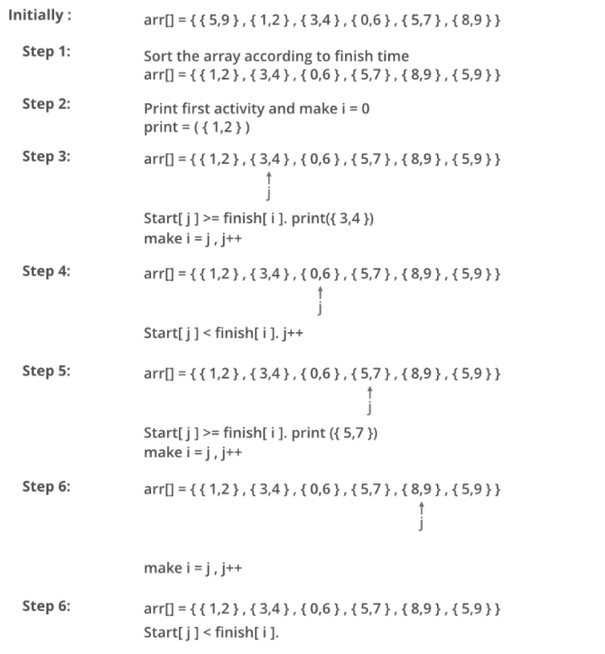
ACTIVITY SELECTION PROBLEM

Slide 12
ACTIVITY SELECTION PROBLEM
Program
Activities are sorted here
Sample IO
Input
start = {1, 3, 0, 5, 8, 5};
end = {2, 4, 6, 7, 9, 9};
Output
0 1 3 4
Time Complexity: O(n)

Slide 13
ACTIVITY SELECTION PROBLEM
import java.io.*; import java.lang.*; import java.util.*; class ActivitySelection { public static void printMaxActivities(int s[], int f[],int n) { int i, j; System.out.println( "Following activities are selected"); i = 0; System.out.print(i + " "); for (j = 1; j < n; j++) { if (s[j] >= f[i]) { | System.out.print(j + " "); i = j; }} } public static void main(String[] args) { int s[] = { 1, 3, 0, 5, 8, 5 }; int f[] = { 2, 4, 6, 7, 9, 9 }; int n = s.length; printMaxActivities(s, f, n); } }

Slide 14




THANK YOU
+91 78150 95095
codemithra@ethnus.com
www.codemithra.com

